Slide 1




Munir
Navigate the world with confidence
Presented by
Rama Khalid Alomair
Fajer Mohammed Alamro
Mashael Khaled Alammar
Aljawharah Ahmed Alsubaie
Supervised by
Dr.Nora Abdulaziz Alhammad

Slide 2
Outline
01
Introduction
05
Design
02
Background & Literature Review
06
Testing
03
System Requirements
07
Conclusion & Future Work
04
Product Backlog
08
Achievements & Recognition

Slide 3
Introduction

Slide 4





Problem
Need for Visual Recognition
Fragmented Solutions
Missing Emergency support
Poor Accessibility
Users lack a unified tool to recognize colors, faces, currencies, and text, making daily tasks more difficult
Users need multiple separate apps for different daily tasks.
No integrated way to alert contacts or share location in emergencies.
Existing tools are not designed to adapt to user’s changing needs or abilities

Slide 5
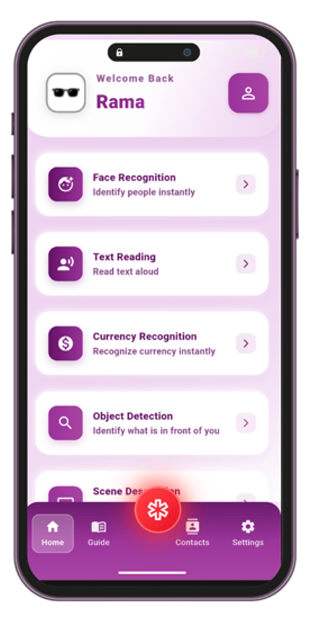

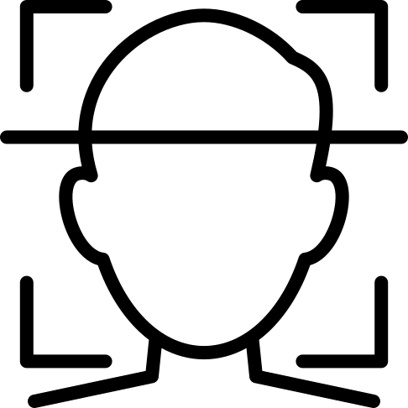
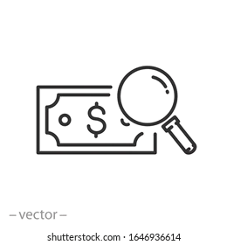







Solution
An integrated AI-powered system: smart glasses + mobile application
object and scene description
OCR & Object detection
AI models
Emergency SOS
Reminders
Voice Commands & TTS
Mobile application

Slide 6



Solution
An integrated AI-powered system: smart glasses + mobile application
Camera
Mic
Smart Glass

Slide 7
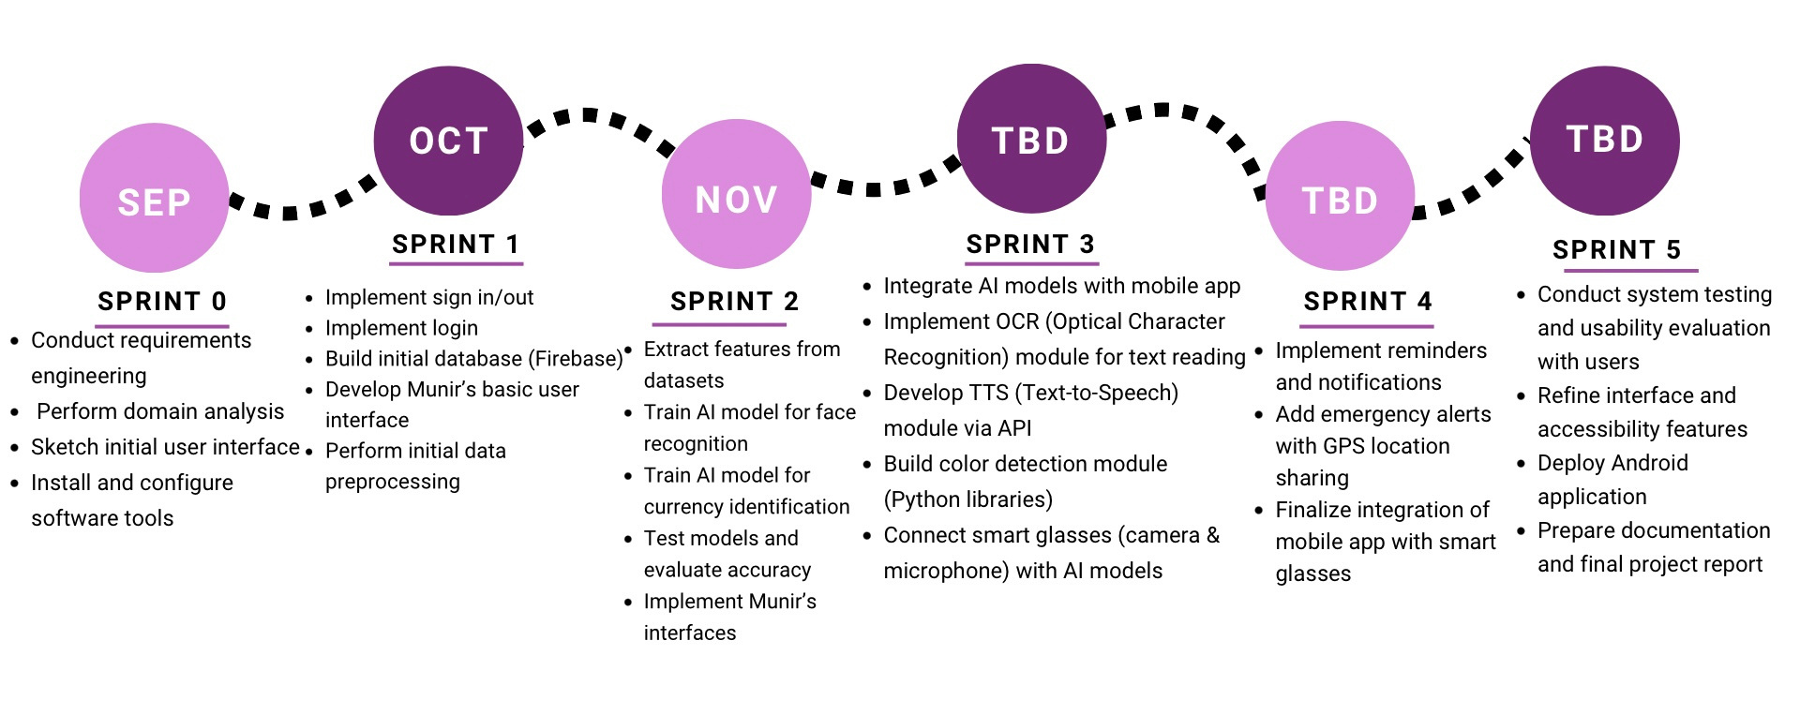
Roadmap

Slide 8
Background & Literature Review

Slide 9
Background
Visual Impairment & Need
2.2 billion people globally affected | 181,728 prevalence in Saudi Arabia
Assistive technology enables:
Navigation & mobility
Information access
Preventing social isolation
Communication
Independence

Slide 10

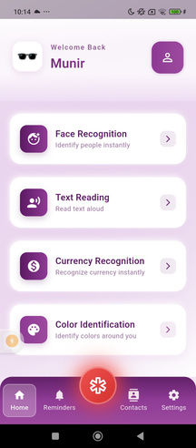

Background
Key Technologies Powering Munir
Smart Glasses Platform
Mobile App
Security & Privacy
AI Capabilities
OCR
TTS Audio Feedback
Face Recognition
Color Detection
Currency Identification
Audio-first design
Voice commands
TalkBack compatible
Hands-free operation
Built-in camera+microphone
AI processing capability
Data encryption
GDPR compliance
Secure authentication
GPS emergency alerts

Slide 11





LITERATURE REVIEW
NuEyes Smart Glasses
OrCam MyEye
Microsoft Seeing AI
smart Vision Glasses (SHG)
Envision Glasses

Slide 12
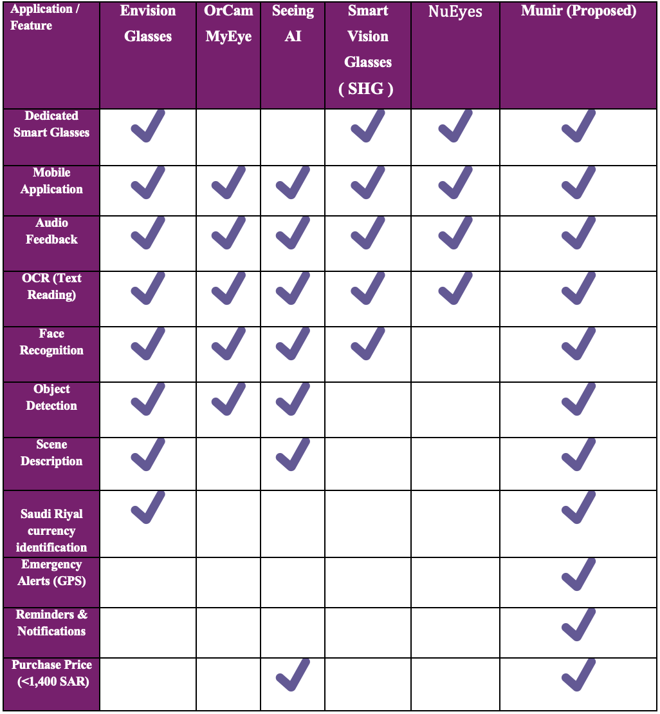
LITERATURE REVIEW

Slide 13
System Requirements

Slide 14


Users
Primary Users: Blind & Visually Impaired
Secondary Users: Caregivers & Family
Diverse ages and educational backgrounds
Beginner to advanced smartphone users
May use screen readers or basic calling/texting only
Support primary users with daily tasks
Receive emergency GPS notifications

Slide 15
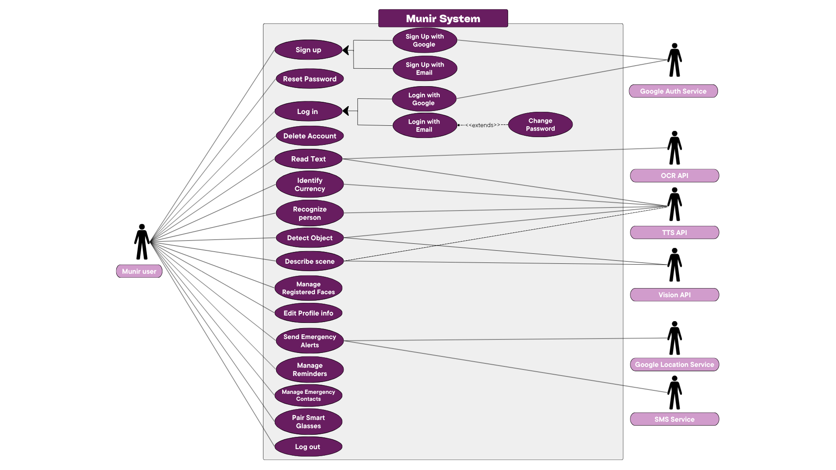
Use Case Diagram

Slide 16
Product Backlog
For Release 2

Slide 17
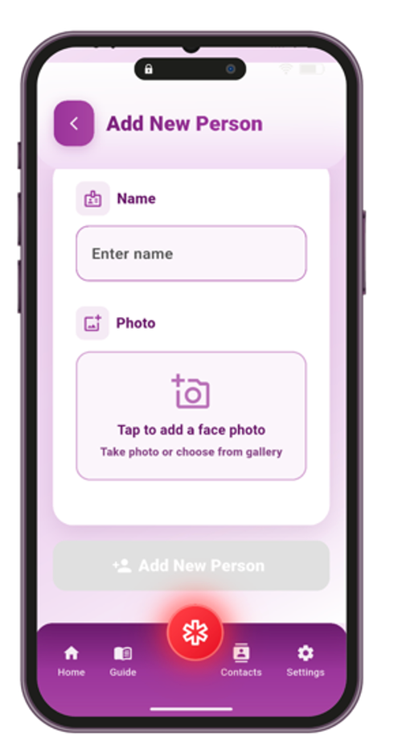
Product Backlog
Release-2
PBI
As a “Munir” user, I want to..
Add a person’s face and name, so that the system can later recognize and identify them
GP-9

Slide 18
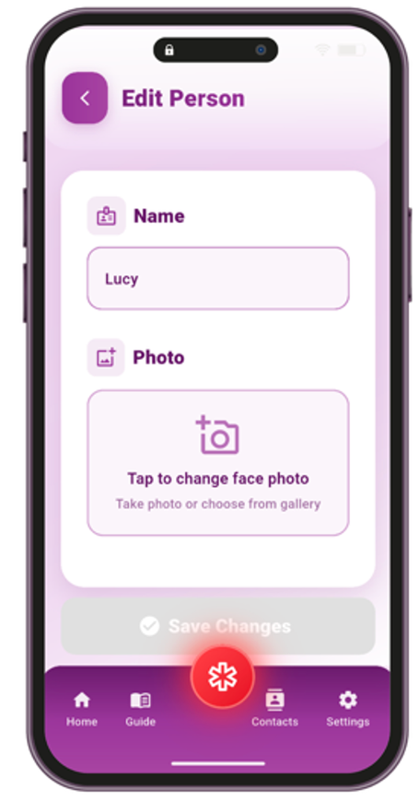
Product Backlog
Release-2
PBI
As a “Munir” user, I want to..
Edit the details of stored faces so that I can keep the information updated
GP-10

Slide 19
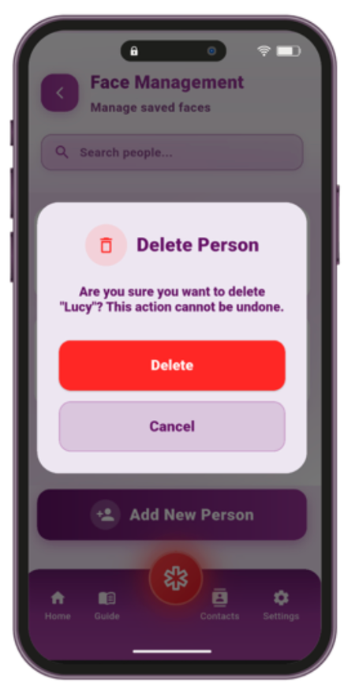
Product Backlog
Release-2
PBI
As a “Munir” user, I want to..
Delete previously registered faces, so that the database remains accurate and up to date
GP-11

Slide 20
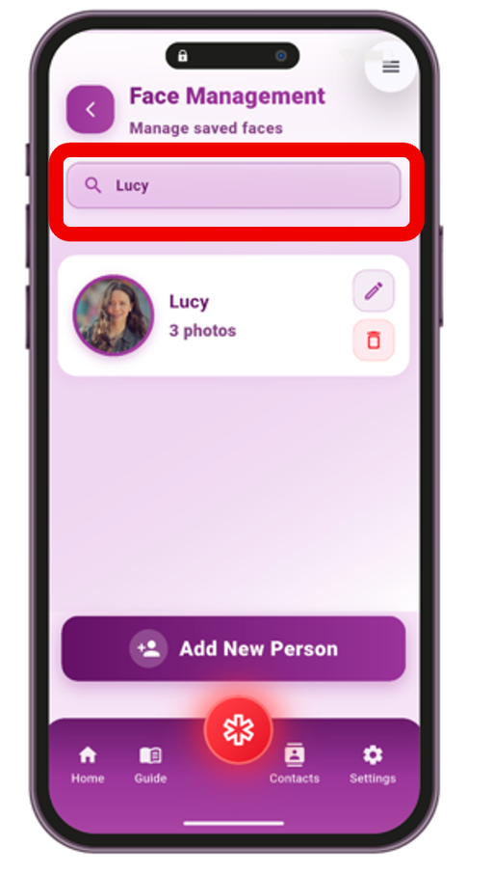
Product Backlog
Release-2
PBI
As a “Munir” user, I want to..
Search for a stored person by name, so that I can easily find and manage them
GP-12

Slide 21
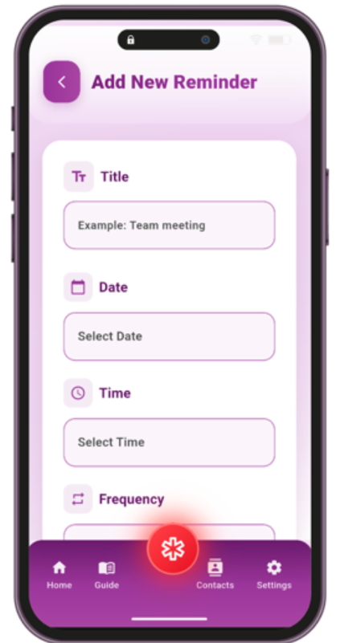
Product Backlog
Release-2
PBI
As a “Munir” user, I want to..
Create reminders with a title, date, time, and frequency, so that I receive notifications at the right time on my phone
GP-13

Slide 22
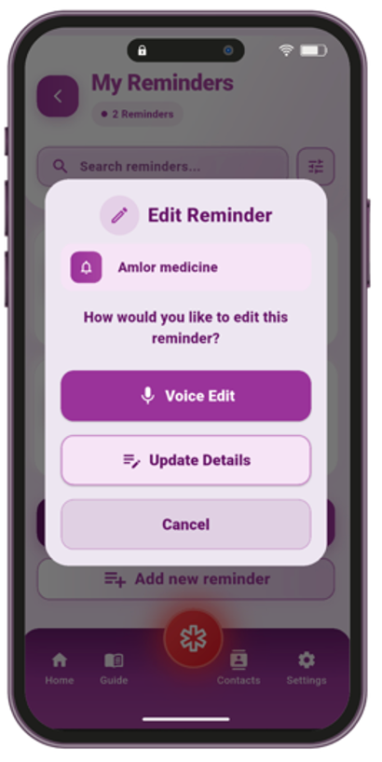
Product Backlog
Release-2
PBI
As a “Munir” user, I want to..
Edit existing reminders, so that I can update them when my plans change
GP-14

Slide 23
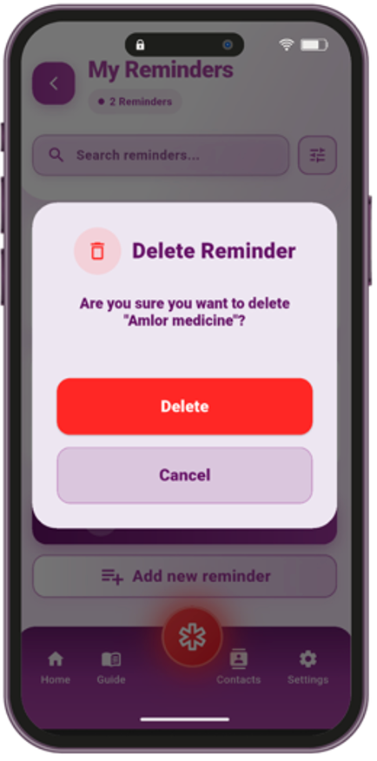
Product Backlog
Release-2
PBI
As a “Munir” user, I want to..
Delete reminders, so that I can keep my reminder list organized
GP-15

Slide 24
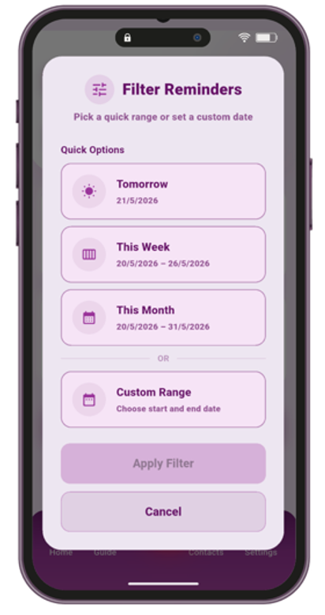
Product Backlog
Release-2
PBI
As a “Munir” user, I want to..
Filter reminders by date, so that I can quickly find a specific reminder.
GP-16

Slide 25
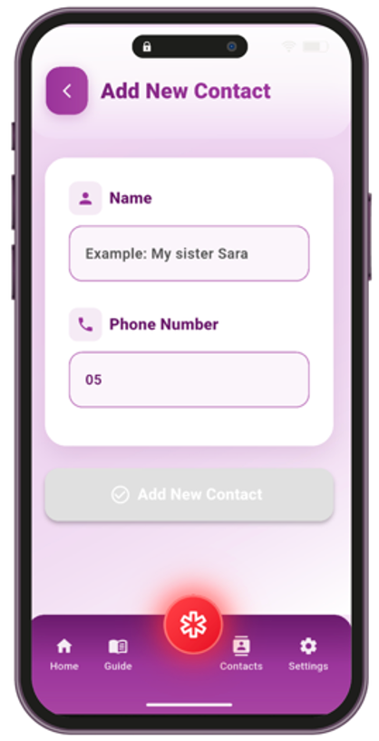
Product Backlog
Release-2
PBI
As a “Munir” user, I want to..
Add emergency contacts so that they are notified when I trigger the SOS alert
GP-17

Slide 26
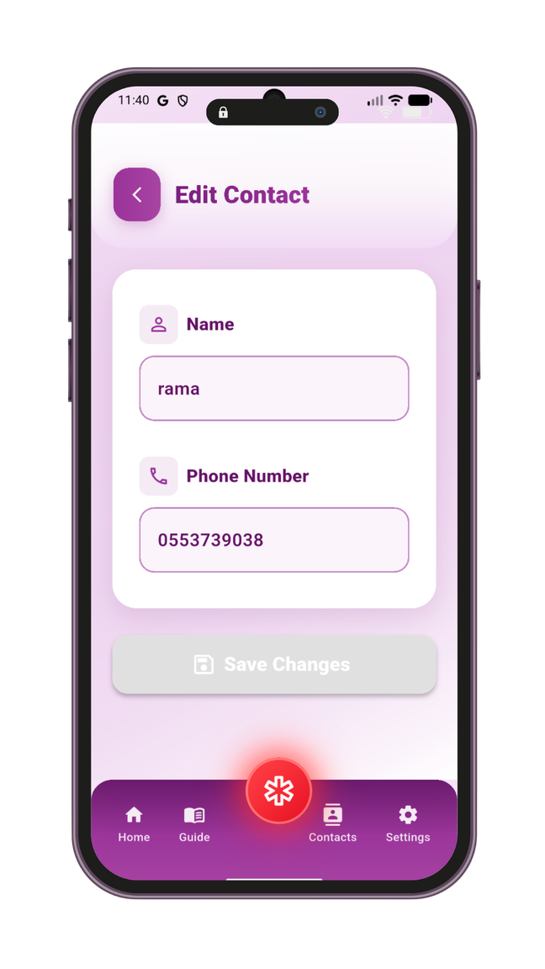
Product Backlog
Release-2
PBI
As a “Munir” user, I want to..
Edit existing emergency contacts, so that I can keep their information accurate
GP-18

Slide 27
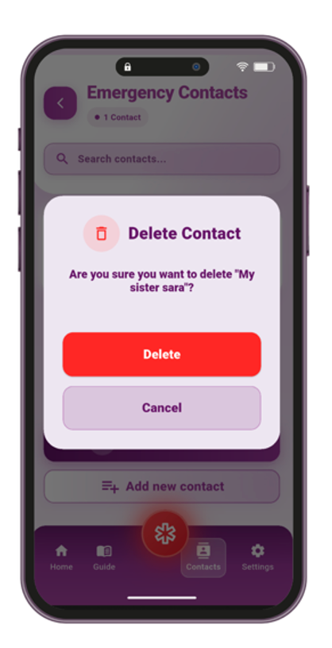
Product Backlog
Release-2
PBI
As a “Munir” user, I want to..
Delete an emergency contact, so that my emergency list stays up to date and relevant
GP-19

Slide 28
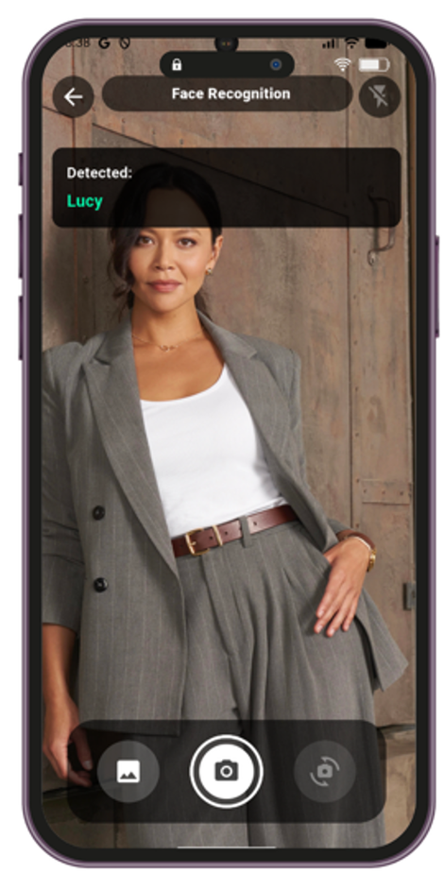
Product Backlog
Release-2
PBI
As a “Munir” user, I want to..
Use the mobile app camera to recognize faces and hear the person’s name spoken aloud, so that I can easily identify people around me when I use my phone
GP-20

Slide 29
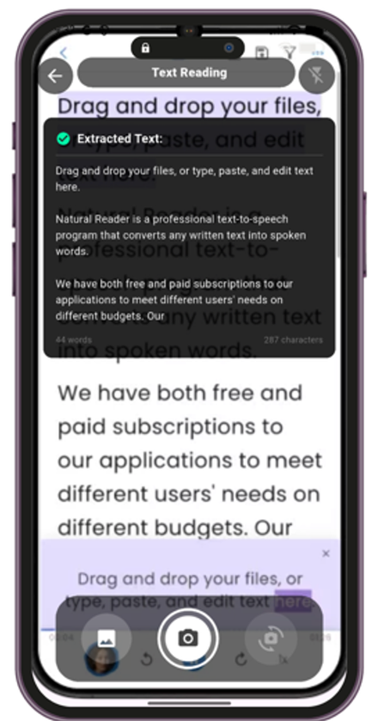
Product Backlog
Release-2
PBI
As a “Munir” user, I want to..
Capture or upload an image with the mobile app camera and have the text read aloud, so that I can easily understand printed content on my phone
GP-21

Slide 30
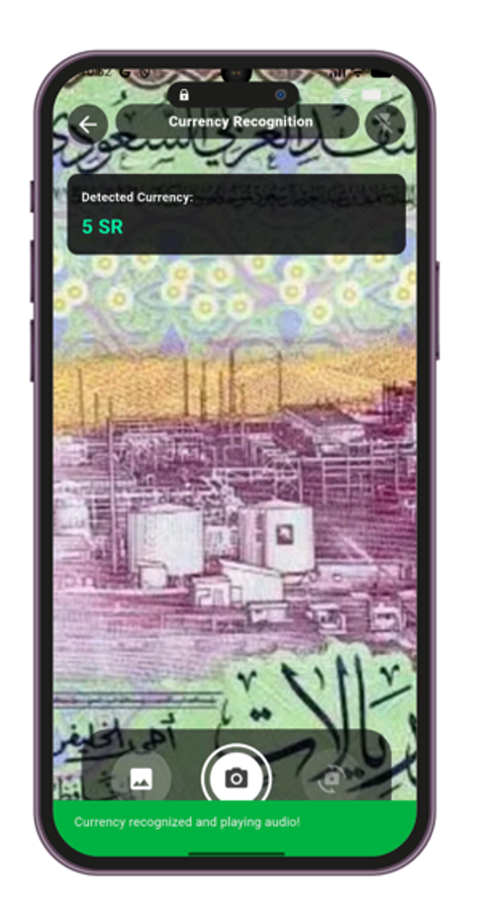
Product Backlog
Release-2
PBI
As a “Munir” user, I want to..
Capture or upload an image of a Saudi currency with the mobile app camera and hear its denomination announced aloud, so that I can easily know its value
GP-22

Slide 31
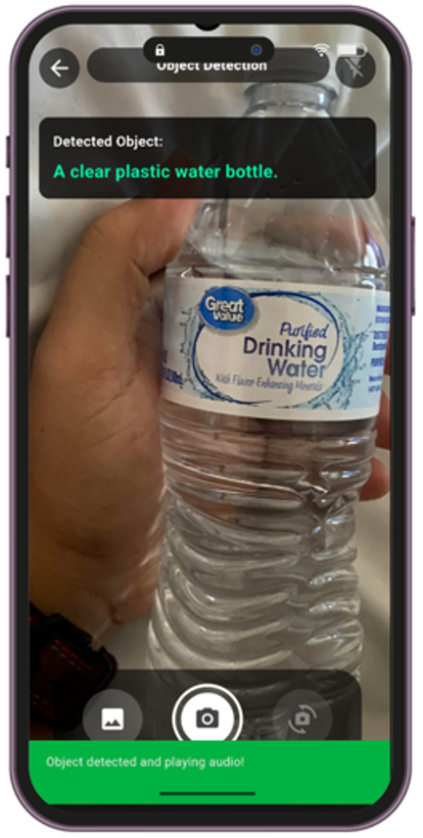
Product Backlog
Release-2
PBI
As a “Munir” user, I want to..
Scan objects with the mobile app camera and hear the object's name and details such as its color spoken aloud, so that I can identify objects using my phone.
GP-23

Slide 32
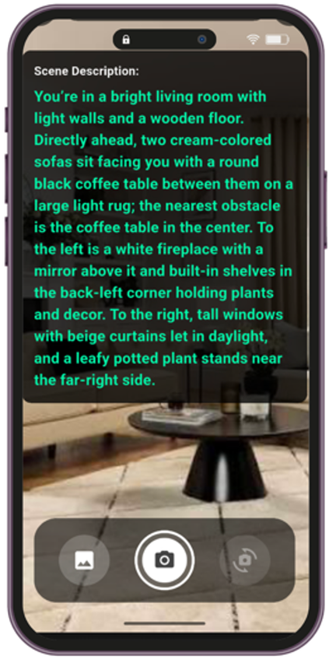
Product Backlog
Release-2
PBI
As a “Munir” user, I want to..
Scan my surrounding environment using the mobile app camera and hear a spoken description of the scene, so that I can better understand my surroundings independently
GP-24

Slide 33
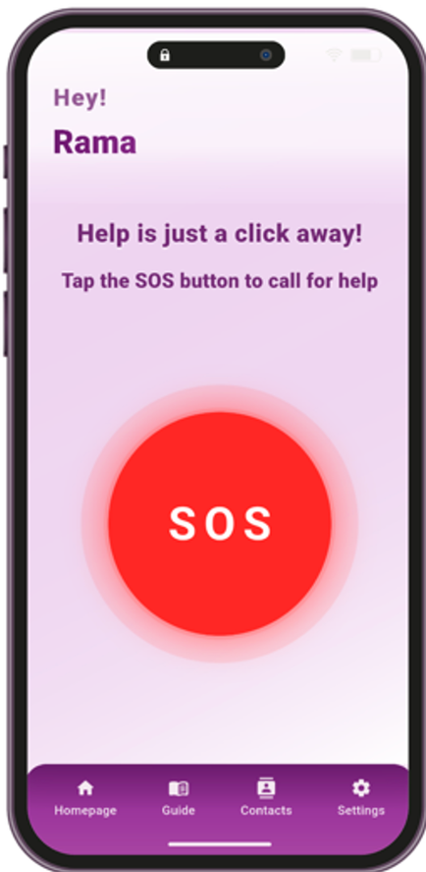

Product Backlog
Release-2
PBI
As a “Munir” user, I want to..
Trigger an SOS that shares my real-time location via SMS, so that my emergency contacts can reach me quickly
GP-25

Slide 34
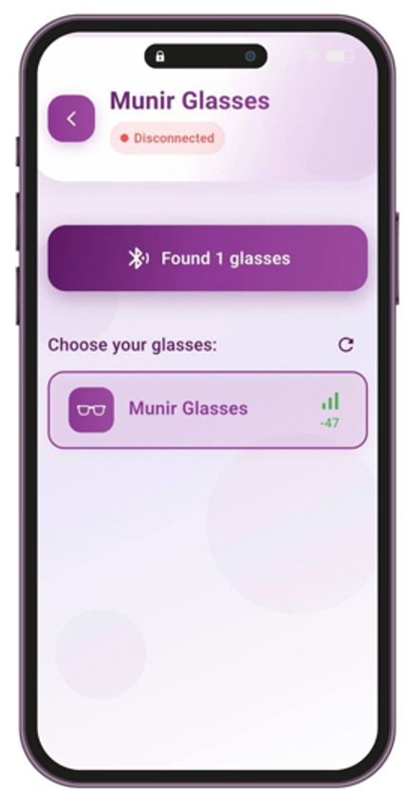
Product Backlog
Release-2
PBI
As a “Munir” user, I want to..
Connect or disconnect my smart glasses via Bluetooth, so that the application can manage the connection when needed
GP-26

Slide 35
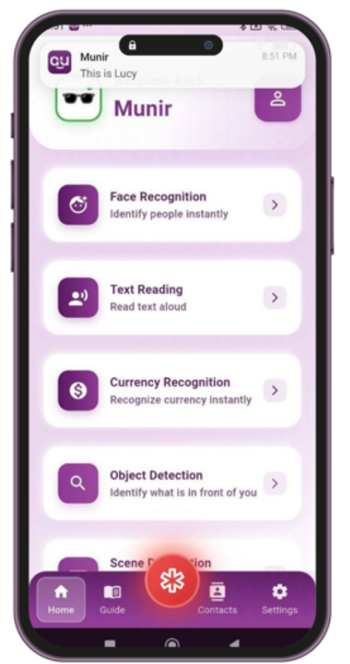
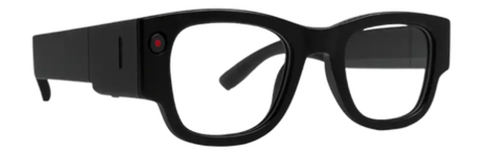
Product Backlog
Release-2
PBI
As a “Munir” user, I want to..
Use the smart glasses camera to recognize faces and hear the person’s name announced in real time, so that I can instantly know who is around me
GP-27

Slide 36
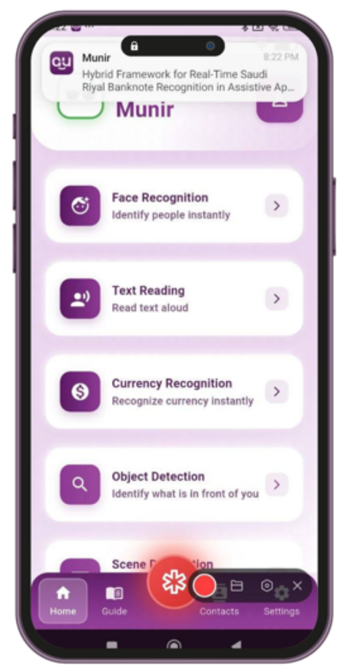
Product Backlog
Release-2
PBI
As a “Munir” user, I want to..
Use the smart glasses camera to capture text and hear it read aloud instantly, so that I can understand written content
GP-28

Slide 37
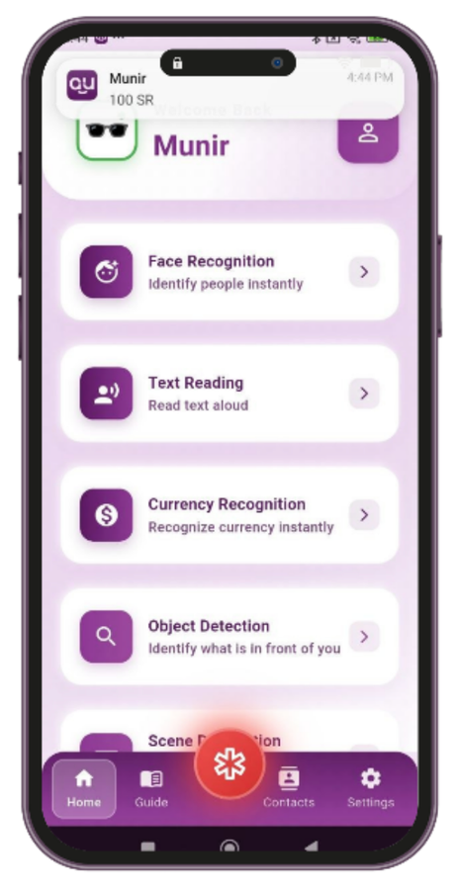
Product Backlog
Release-2
PBI
As a “Munir” user, I want to..
Use the smart glasses camera to identify Saudi currency and hear their denomination spoken instantly, so that I can know its value
GP-29

Slide 38
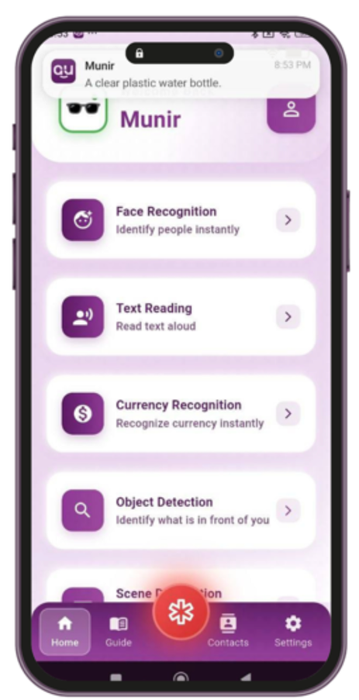
Product Backlog
Release-2
PBI
As a “Munir” user, I want to..
Use the smart glasses camera to detect objects and their colors and hear them announced instantly, so that I can recognize them in real time
GP-30

Slide 39
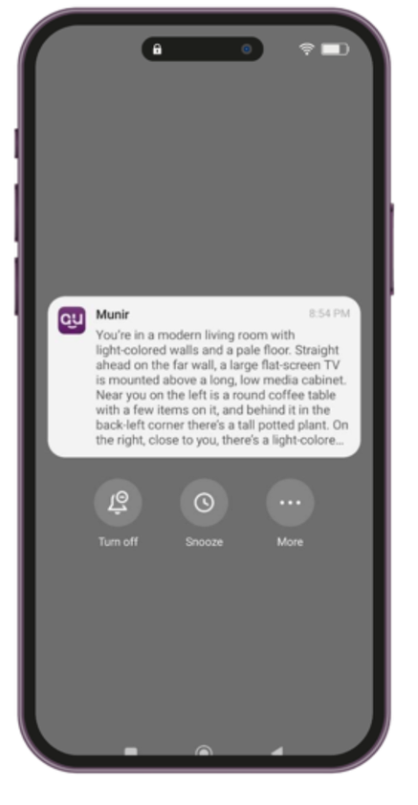
Product Backlog
Release-2
PBI
As a “Munir” user, I want to..
Use the smart glasses camera to scan my surroundings and hear a spoken description of the scene, so that I can better understand my environment in real time
GP-31

Slide 40
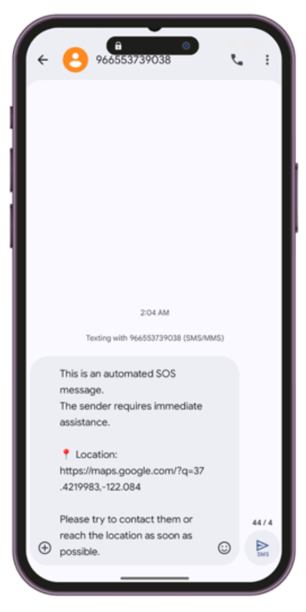
Product Backlog
Release-2
PBI
As a “Munir” user, I want to..
Trigger SOS by saying a wake phrase, so that my emergency contacts receive my location via SMS
GP-32

Slide 41
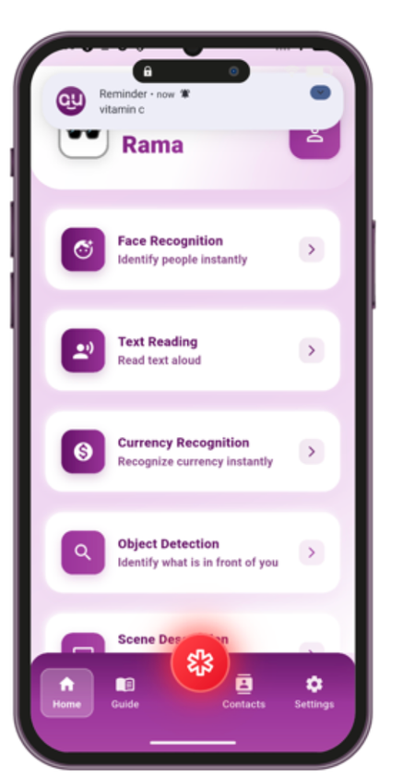

Product Backlog
Release-2
PBI
As a “Munir” user, I want to..
Receive a notification on my mobile phone when a scheduled reminder time arrives, so that I can be notified on time
GP-33

Slide 42
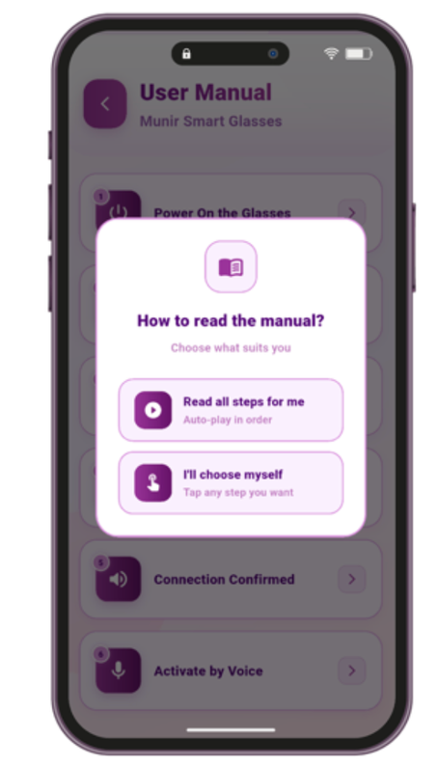
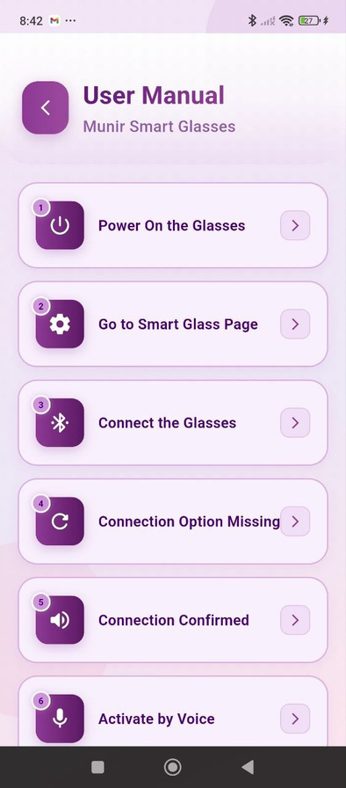

Product Backlog
Release-2
PBI
As a “Munir” user, I want to..
Access the User Manual from the footer,so that I can read information about the glasses, how to connect them, how to use them, and troubleshoot issues whenever needed.
GP-33

Slide 43
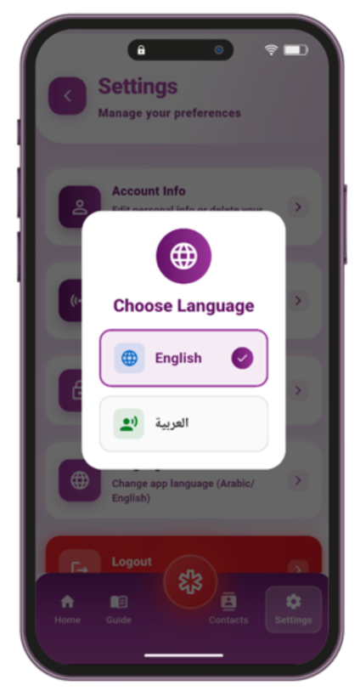
Product Backlog
Release-2
PBI
As a “Munir” user, I want to..
Change the application language from the Settings page,
so that I can use the application in either Arabic or English according to my preference
GP-34

Slide 44
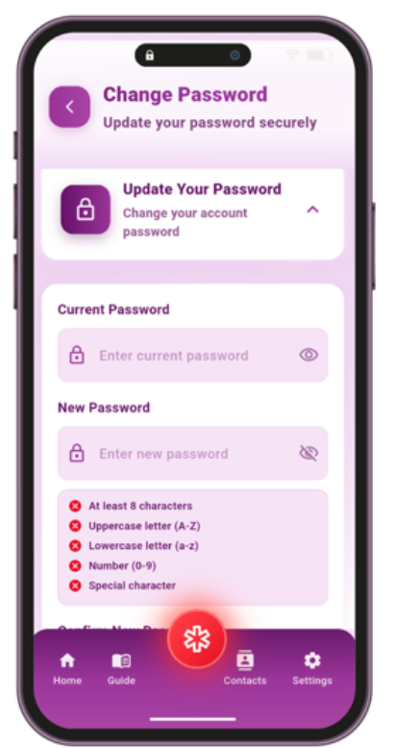
Product Backlog
Release-2
PBI
As a “Munir” user, I want to..
Change my account password so that I can protect my account from unauthorized access
GP-35

Slide 45
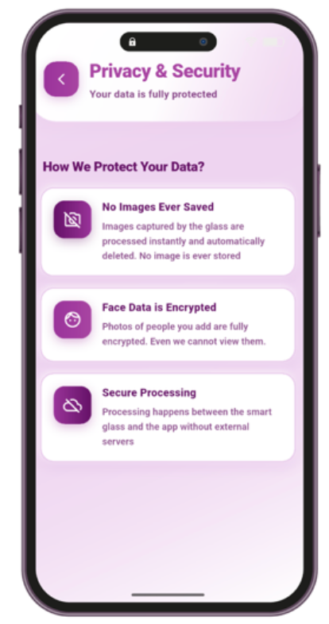
Product Backlog
Release-2
PBI
As a “Munir” user, I want to..
Access a “Privacy & Security” so that I can understand how my data is stored and protected
GP-36

Slide 46
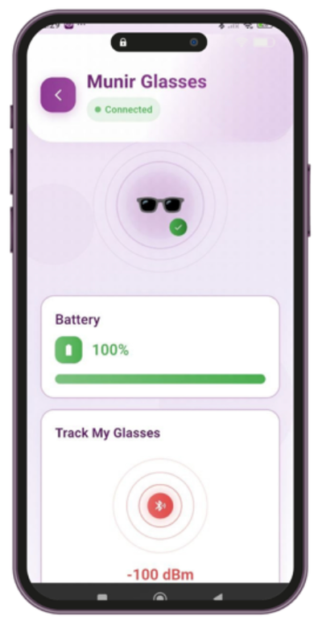
Product Backlog
Release-2
PBI
As a “Team Member” , I want to..
Test notification delivery between the smart glasses and the mobile application, so that I can ensure notifications are received and function correctly
GP-37

Slide 47
Product Backlog
Release-2
PBI
As a “Munir” user, I want to..
Store my captured images securely in the cloud with encryption, so that my personal data remains private and protected while still being accessible across devices
GP-38
Non-Functional Requirements

Slide 48
Product Backlog
Release-2
PBI
As a “Munir” user, I want to..
Have a simple and intuitive application interface, so that I can use it without errors after a short learning period of time.
GP-39
Non-Functional Requirements

Slide 49
Product Backlog
Release-2
PBI
As a “Munir” user, I want to..
Receive clear voice feedback on my mobile phone for smart glasses responses, so that I can easily understand the system's responses without visual assistance.
GP-40
Non-Functional Requirements

Slide 50
Design

Slide 51
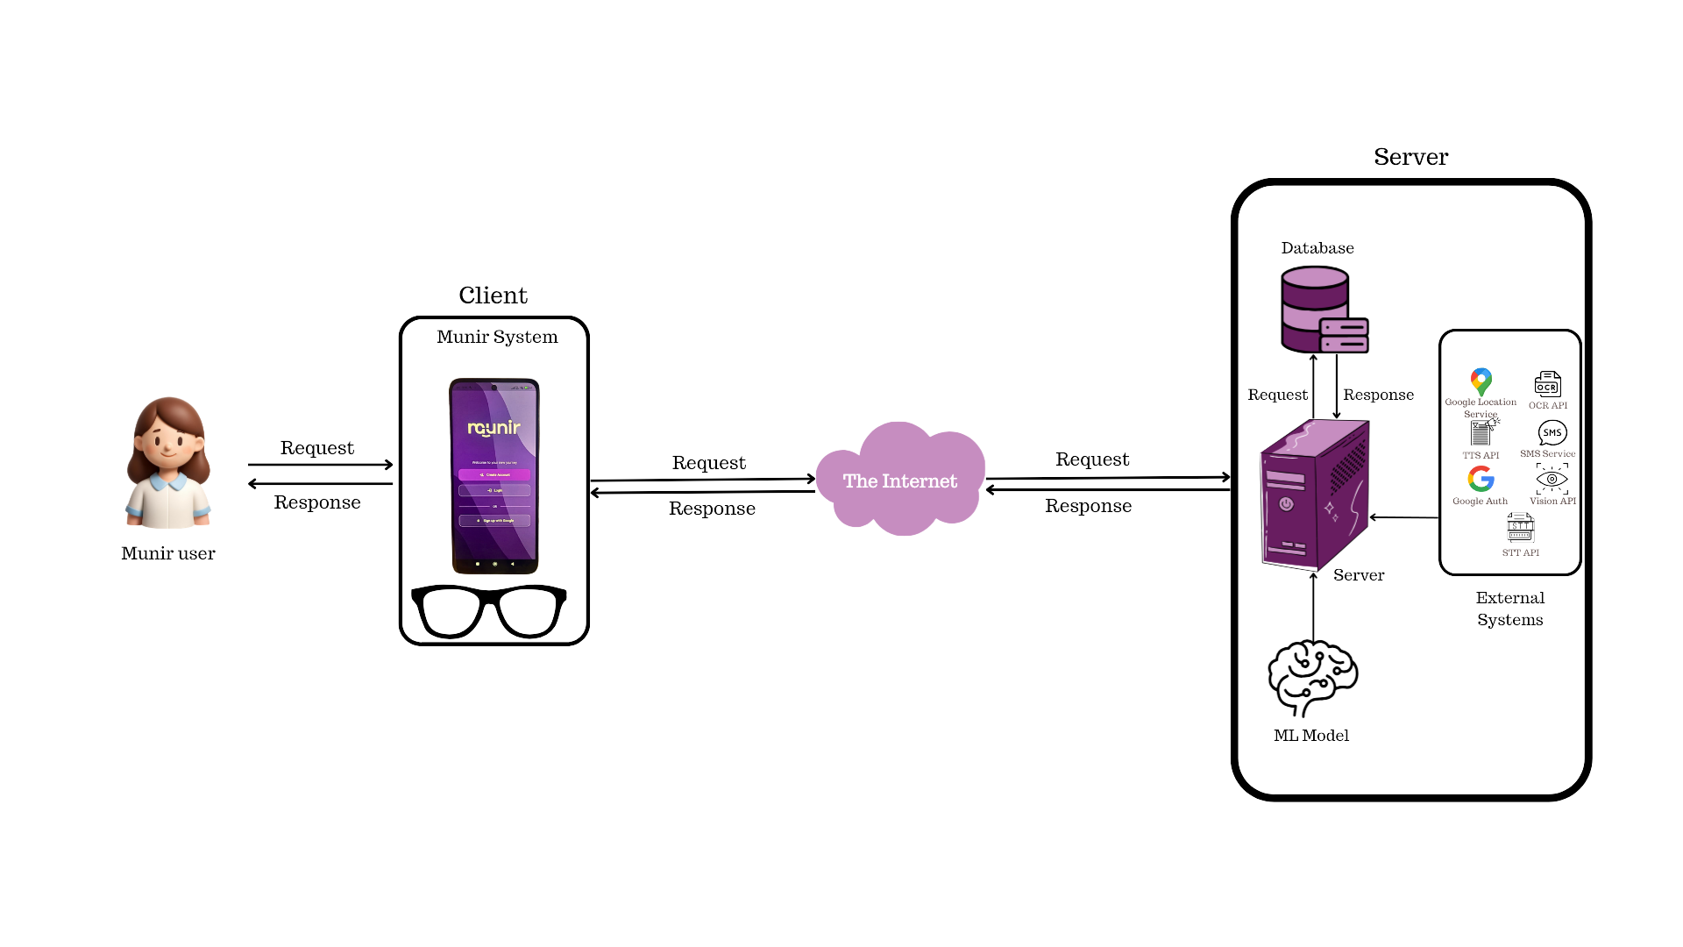
Architecture Diagram

Slide 52
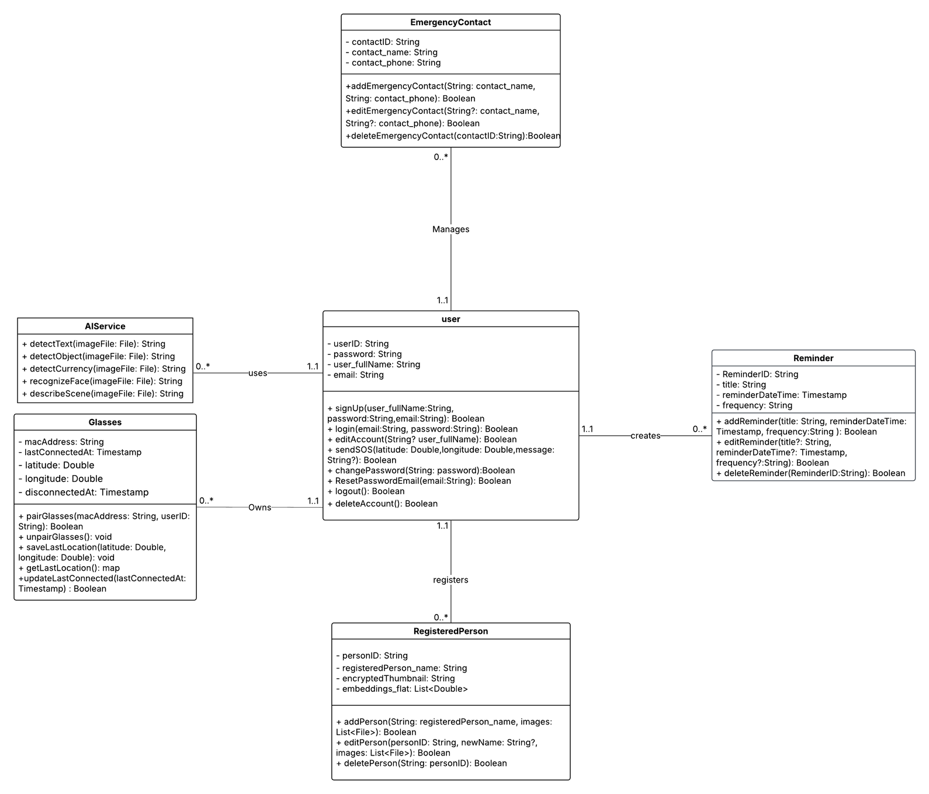
Class Diagram

Slide 53
Data Design

Slide 54
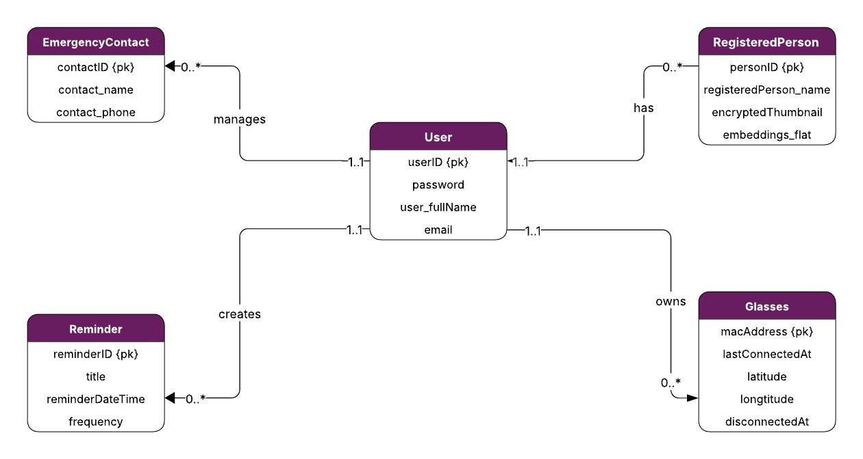
ER Diagram

Slide 55
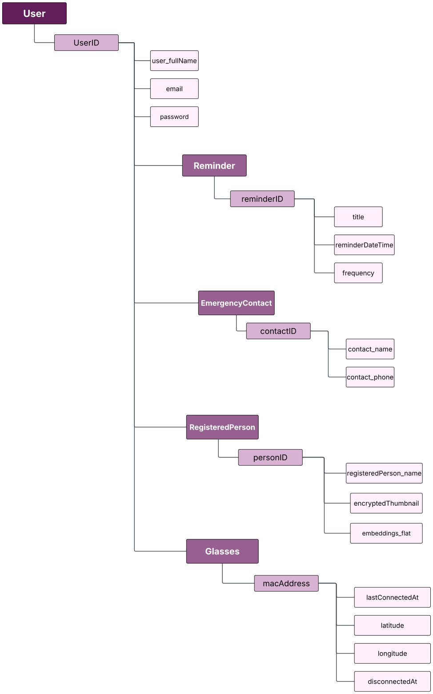
Non-relational Model

Slide 56
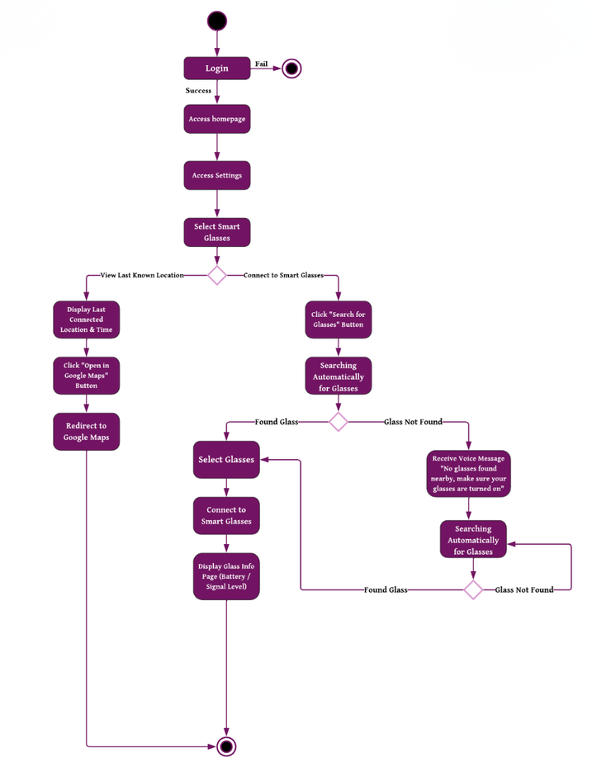
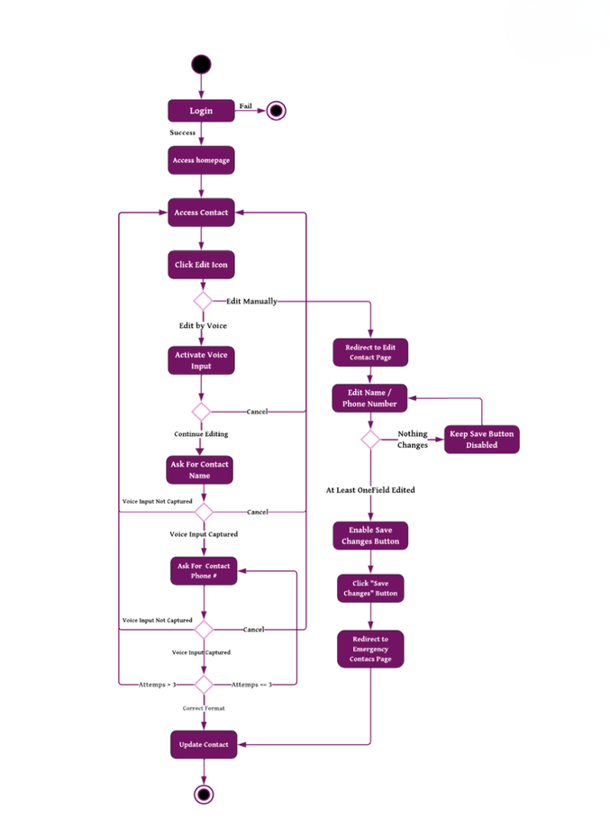
Component level design
Activity Diagram of the Smart Glasses Connection process
Activity Diagram of Edit Emergency Contact Process

Slide 57
SMART GLASSES

Slide 58


What is Omi Glass?
Omi Glass — AI Smart Glasses
Built on XIAO ESP32-S3 Sense
Strong battery — 6 × 150mAh cells
Fully open-source & customizable firmware

Slide 59

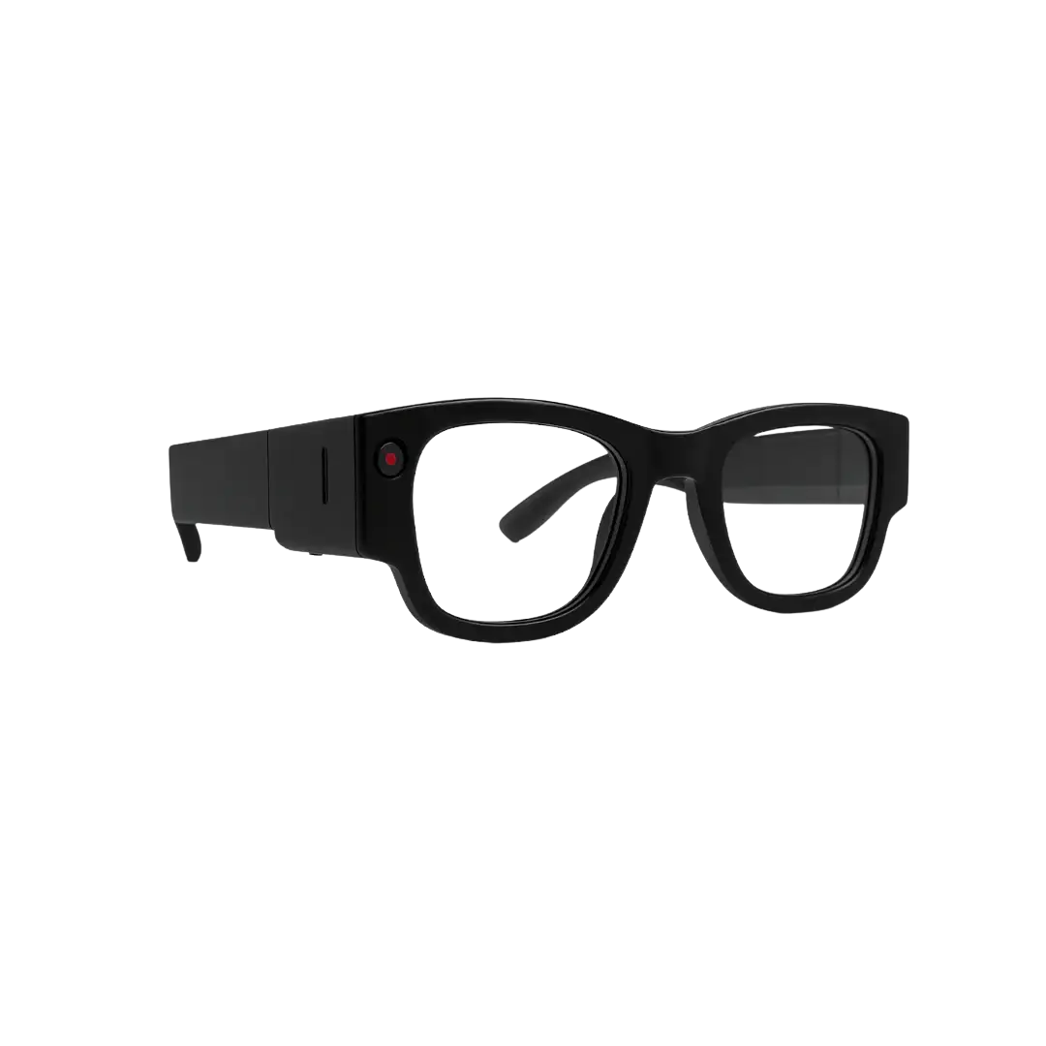
Hardware Components
OV2640 Camera
XIAO ESP32-S3
Battery — 900mAh
PDM Digital Microphone
Multifunction Button
Hold = Power On/Off
Press = Capture & Send

Slide 60
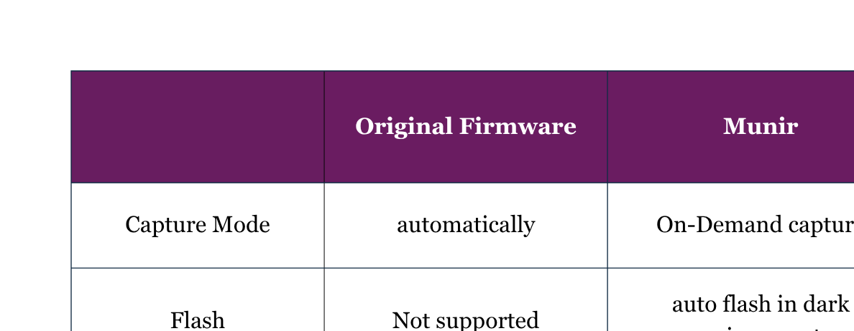
Our Firmware Modifications

Slide 61
Testing

Slide 62
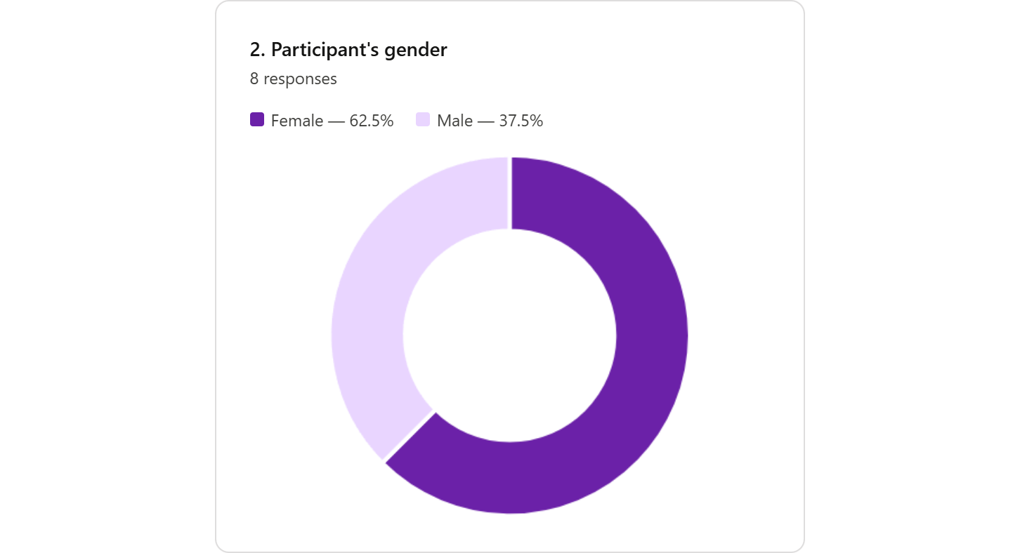


UAT - Demographics of participants
8 participants

Slide 63
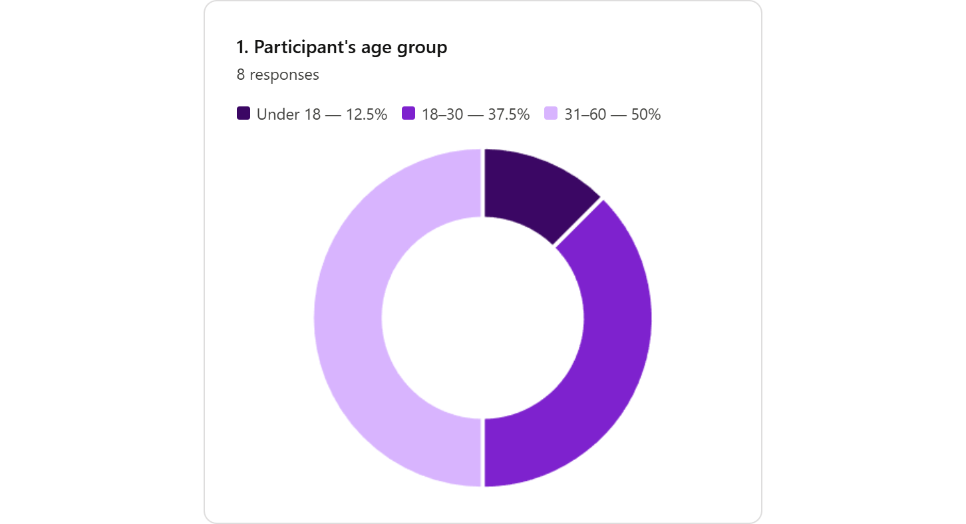
UAT - Demographics of participants
Age Group

Slide 64
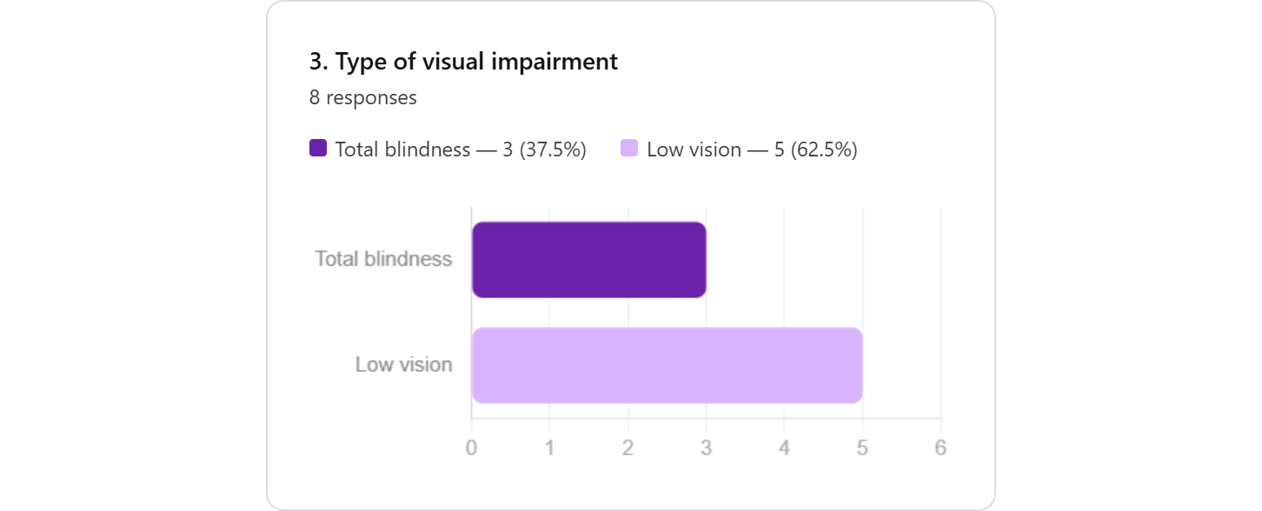
UAT - Demographics of participants
Types of Visual Impairment

Slide 65

UAT - Demographics of participants
Technical skills

Slide 66



evaluation main areas
MOBILE APPLICATION FEATURES
APPLICATION USABILITY
SMART GLASSES FEATURES

Slide 67


Questionnaire Results
Mobile Application Features
Language Used
Managing People for Face Recognition

Slide 68


Questionnaire Results
Mobile Application Features
Face Recognition Accuracy
Currency Identification

Slide 69


Questionnaire Results
Mobile Application Features
Text Reading Accuracy
Object Detection

Slide 70


Questionnaire Results
Mobile Application Features
Scene Description
Reminders Management

Slide 71


Questionnaire Results
Mobile Application Features
Filtering Reminders
Contacts Management

Slide 72


Questionnaire Results
Mobile Application Features
Voice Input Feature
SOS Feature

Slide 73


Questionnaire Results
Smart Glasses Features
Connecting Smart Glasses
Viewing Smart Glasses Information

Slide 74


Questionnaire Results
Smart Glasses Features
Face Recognition via Smart Glasses
Currency Identification via Smart Glasses

Slide 75


Questionnaire Results
Smart Glasses Features
Text Reading via Smart Glasses
Object Recognition via Smart Glasses

Slide 76


Questionnaire Results
Smart Glasses Features
Scene Description via Smart Glasses
SOS Feature via Smart Glasses

Slide 77


Questionnaire Results
Smart Glasses Features
Accessing User Guide
Disconnecting Smart Glasses

Slide 78


Questionnaire Results
General Application Features
Changing Language Application
Application Design and Ease of Finding Information

Slide 79


Questionnaire Results
General Application Features
App Navigation Ease
Audio Guidance Clarity

Slide 80
Discussion
Overall Evaluation:
Munir provides an accessible voice-driven system for visually impaired users with strong usability across mobile and smart glasses features.
Key Findings:
Strong positive feedback across mobile and smart glasses features.
High usability with easy navigation and clear audio guidance.
Minor usability issues in a few features, indicating areas for improvement.

Slide 81
Conclusion & Future Work

Slide 82






Conclusion & Future Work
Conclusion
Munir represents a meaningful step toward inclusive technology, bridging visual impairment and everyday independence through intelligent AI-powered assistance.
Future Work
On-Device Audio Feedback
Wi-Fi Connectivity Integration
On-Device Functionality Expansion
Multi-Currency Support

Slide 83
Achievements
& Recognition

Slide 84

Achievement & Recognition
IBM AI Developer Program

Slide 85


Achievement & Recognition
Tamkeen X Training Forum
ICAN 2026 – International Conference on Data & AI Capacity Building

Slide 86


Achievement & Recognition
Munir Paper — Accepted
MDPI Sensors
Currency Paper — Under Review
MDPI Applied Sciences

Slide 87

Thank You

Slide 88
Product Backlog
ID
PBI
Size
Type
Acceptance Criteria
1. As a “Munir” user, if I navigate to “Face Recognition” from the Homepage, then I should have access to two options: “Face Management” and “Identify Person”
2. As a “Munir” user, if I select “Face Management,” then a list of all previously added persons should be available
3. As a “Munir” user, if I click on the Add button, I should be redirected to the “Add Person” page where I can enter the person’s name and either upload a face photo or take a new photo
4. As a “Munir” user, if I choose to upload a photo, I should be able to upload images for all required face orientations (front, left, right) so that the system can recognize the person correctly
5. As a "Munir" user, if a required face image is uploaded with the wrong direction (e.g., a left-facing image is provided instead of the required right-facing image), I should receive an error message
6. As a "Munir" user, if the three uploaded orientation photos (front, left, right) contain different people (e.g., the front photo is a different person than the left and right photos), I should receive an error message indicating that the faces do not belong to the same person and must be retaken
As a “Munir” user, I
want to add a person’s
face and name, so that
the system can later
recognize and identify
them
GP-9
3
Feature

Slide 89
Product Backlog
ID
PBI
Size
Type
Acceptance Criteria
1. As a “Munir” user, if I navigate to “Face Recognition” from the Homepage, then I should have access to two options: “Face Management” and “Identify Person”
2. As a “Munir” user, if I select “Face Management,” then a list of all previously added persons should be available
3. As a "Munir" user, if I click the edit button, I should be redirected to the "Edit Person" page where I can update the name and/or modify the face images by uploading a new photo or take a new one
4. As a "Munir" user, if I replace any face image during editing, the same validation rules should apply, incorrect face orientation, mismatched identities across the three photos, or multiple faces in a single photo should each trigger an appropriate error message
5. As a “Munir” user, if I save the changes, then the updated details should be stored in the database, and I should receive a confirmation message indicating the update was successful, with the new details immediately reflected in the Face Management list
6. As a “Munir” user, if I cancel the edit action, then no changes should occur, and the person’s details should remain as they were in the Face Management list
‏
As a “Munir” user, I
want to edit the details
of stored faces (e.g.,
name or photo), so that I can keep the
information updated
GP-10
3
Feature

Slide 90
Product Backlog
ID
PBI
Size
Type
Acceptance Criteria
1. As a “Munir” user, if I navigate to “Face Recognition” from the Homepage, then I should have access to two options: “Face Management” and “Identify Person”
2. As a “Munir” user, if I select “Face Management,” then a list of all previously added persons should be available
3. As a “Munir” user, if I click the delete button, then I should be prompted with a confirmation dialog asking me to confirm or cancel the deletion
4. As a “Munir” user, if I confirm the deletion, then the person’s details should be permanently removed from the database, and I should receive a confirmation message indicating the deletion was successful, with the updated list immediately reflected in the Face Management list
5. As a “Munir” user, if I cancel the deletion, then no changes should occur, and the person’s details should remain as they were in the Face Management list
As a ‘Munir’ user, I
want to delete
previously registered
faces, so that the
database remains
accurate and up to date
GP-11
2
Feature

Slide 91
Product Backlog
ID
PBI
Size
Type
Acceptance Criteria
As a “Munir” user, I
want to search for a
stored person by name, so that I can easily find and manage them
1. As a “Munir” user, if I navigate to “Face Recognition” from the
Homepage, then I should have access to two options: “Face Management” and “Identify Person”
2. As a “Munir” user, if I select “Face Management,” then a list of all previously added persons should be available
3. As a “Munir” user, if I type a name in the search bar, then the list should dynamically filter to show only the persons whose names match my input
4. As a “Munir” user, if there are no matches for my search, then I should receive a message indicating that no persons were found
5. As a “Munir” user, if I clear the search input, then the full list of stored persons should be displayed again
GP-12
3
Feature

Slide 92





Model Development Pipeline
1. DATA COLLECTION
3. FEATURE EXTRACTION
5.MODEL EVALUATION
2. DATA PREPROCESSING
4.MODEL TRAINING & VALIDATION

Slide 93








Face Recognition Integration
Registration path
Encrypt thumbnails (AES-256-CBC + IV)
Saved to
DB
Capture / Upload 3-angle facial images
InsightFace 512-dimensional embeddings
Capture / Upload a photo
Match against registered embeddings
Person identified & name announced
Recognition path

Slide 94


Face Recognition Model
1. Data Collection
VGGFace2 Dataset
540 identities | ~198,000 images
Available on Kaggle
Diverse: age, ethnicity, pose, lighting

Slide 95






Face Recognition Model
2. Data Preprocessing
Duplicate Detection
Image Collection
Data cleaning
Train-Test Split
Removed duplicates files
Selected 60 images per person
Remove corrupted files Standardize to RGB & JPEG
80% train (25,920 images)
20% test (6,480 images)
FINAL DATASET: 32,400 TOTAL IMAGES | 540 CLASSES

Slide 96



Face Recognition Model
3. Feature extraction using InsightFace
Stage 1
Stage 2
Face Alignment
Stage 3
Embedding Generation
Face Detection (SCRFD)
Detects faces in 224×224 images
Identifies 5 key landmarks
Normalizes to 112×112 format using landmarks
Generates 512-dimensional vectors
L2-normalized for similarity comparison
RESULT: 512-D FEATURE VECTORS REPRESENTING EACH FACE

Slide 97

Face Recognition Model
4.Model Training & Validation
Classifiers Trained
Cross-Validation
SVM (Linear)
Logistic Regression
SVM (RBF)
5-Fold Stratified CV on training set

Slide 98

Face Recognition Model
5.Model testing
Test Set:
6,436 samples (never seen during training/validation)
Final evaluation on held-out data
Test Results:

Slide 99




Currency Recognition Model
1.Data Collection
ALfloos Dataset
Saudi Riyal denominations: 5, 10, 50, 100, 200, 500 SAR
Balanced dataset with real-world diversity
Added missing 20 SAR manually
Selected polymer 5 SAR only
(Excluded cotton - 98.67% similar)

Slide 100

Currency Recognition Model
2. Data Preprocessing
Duplicate Detection
Data Cleaning
Train-Test Split
Data Augmentation
Removed 44
duplicates
Validated 1,256
images
70% train (876)
30% test (380)
876 → 2,447 images
350 images per class (balanced)
FINAL DATASET: 2,827 TOTAL IMAGES

Slide 101



Currency Recognition Model
3. Feature extraction using MobileNetV2
Input Images
Normalization
Feature Extraction
Output Vectors
224×224 RGB currency images
ImageNet normalization applied
Pre-trained MobileNetV2 on ImageNet
Generates 1280-dimensional vectors
RESULT: 1280-D FEATURE VECTORS PER CURRENCY IMAGE

Slide 102

Currency Recognition Model
4. Model Training & Validation
Classifiers Trained
Cross-Validation
5-Fold Stratified CV on training set
SVM (Linear)
Logistic Regression
SVM (RBF)

Slide 103


Currency Recognition Model
5. Model Testing
Test Set:
380 unseen samples
Never used during training
Test Results:
Selected Model:
SVM (RBF)
Confusion matrix

